Slide 1

Practice Questions
Lesson 1 & 2
Prof. Saurabh’s class
10 Nov 2025, Monday

Slide 2
Part 1
Matrix Operations
Target for 10 Nov 2025, Monday
Refresher video links:
Matrix Multiplication
Determinants
Inverse

Slide 3
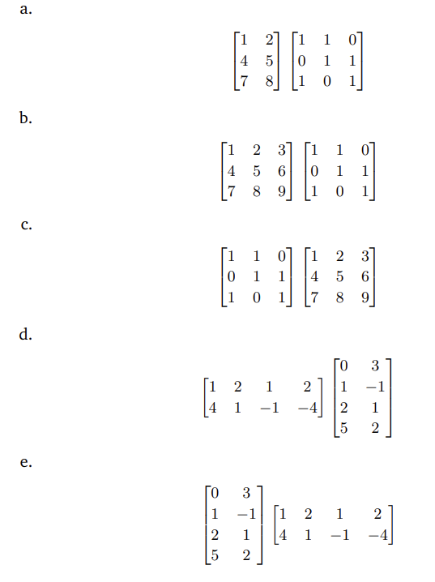

Question 2.4
Notes:
Diesenroth pg 64-65

Slide 4
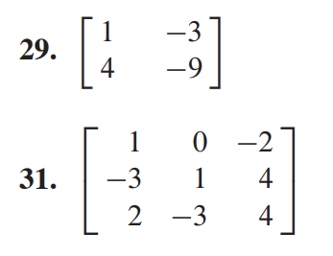
Section 2.2
Notes:
David C Lay - pg 110

Slide 5
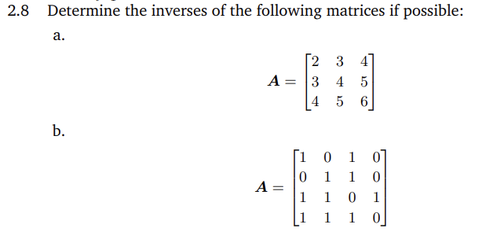
Question 2.8
Notes:
Diesenroth pg 66

Slide 6
Part 2
System of Linear Eqn
Target for 11 Nov 2025, Tuesday
Refresher video links:
Intro to Linear Eqn
Solving Linear Eqns

Slide 7
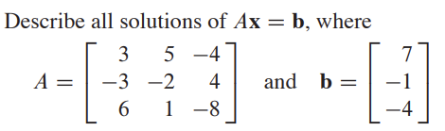
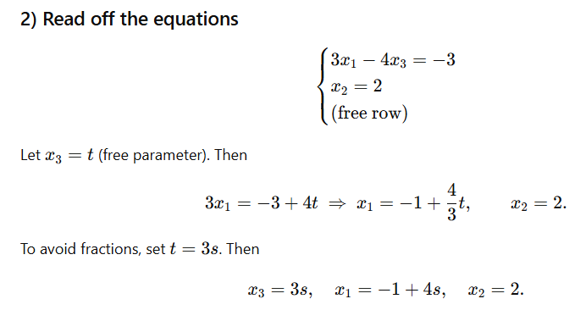
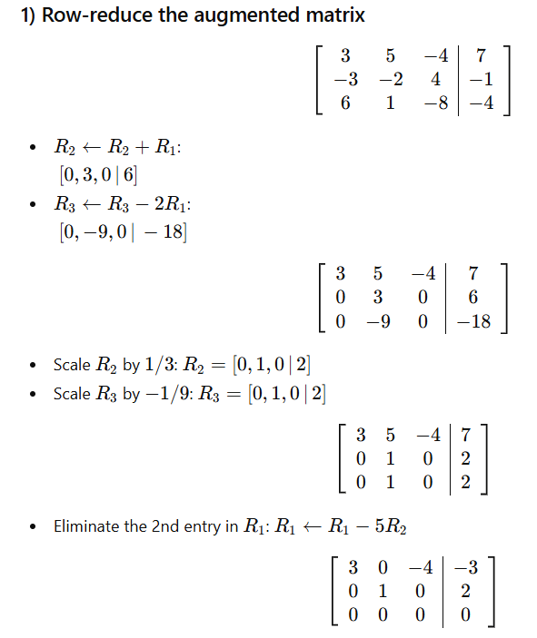
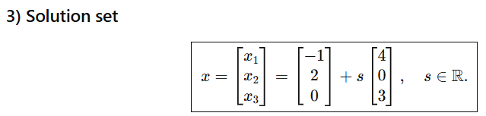
Refresher - NonHomogeneous
Notes:
Diesenroth pg 65

Slide 8

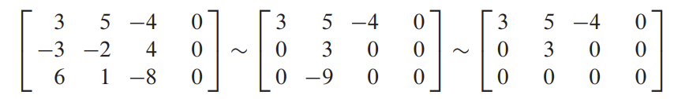
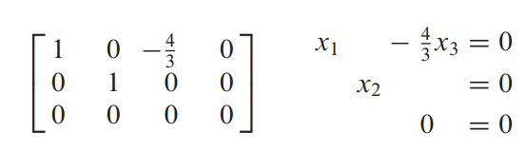
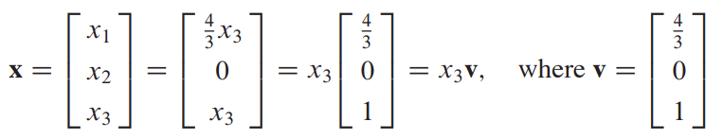
Refresher - Homogeneous
Notes:
Diesenroth pg 65

Slide 9
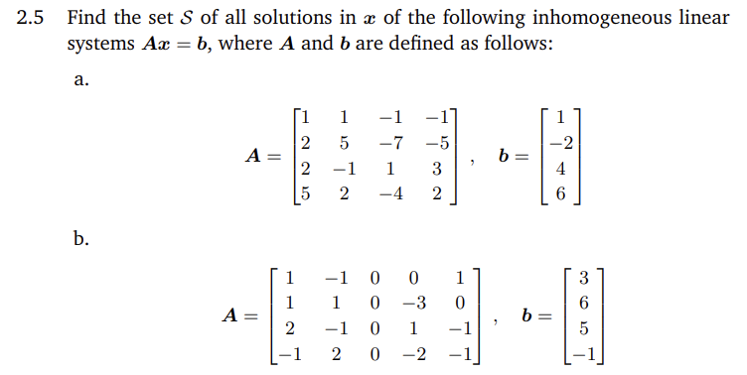
Question 2.5
Notes:
Diesenroth pg 65

Slide 10
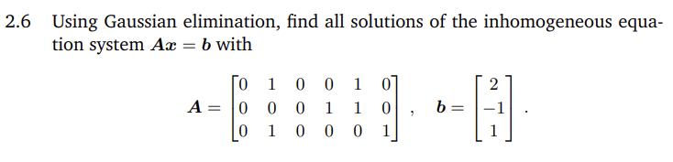
Question 2.6
Notes:
Diesenroth pg 65

Slide 11
Part 3
Linear Independence
Refresher video: https://www.youtube.com/watch?v=9kDpbZCK62Y
Reference slides: Lesson 2 - slides 20 to 22

Slide 12


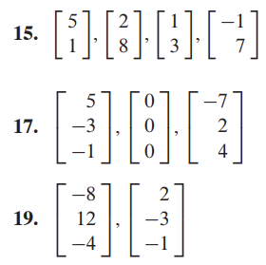
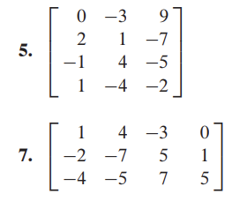
Section 1.7
Notes:
David C Lay - pg 60

Slide 13
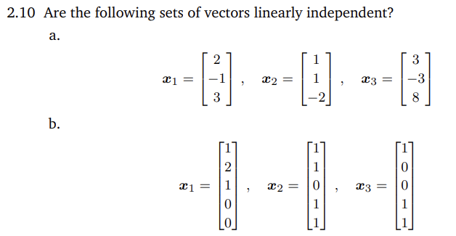
Question 2.10
Notes:
Diesenroth pg 66

Slide 14
Part 4
Vector Space

Slide 15
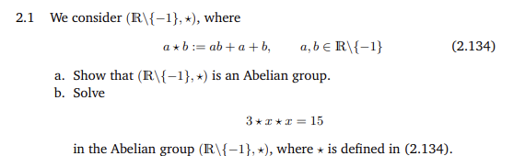
Question 2.1
Notes:
Diesenroth pg 64

Slide 16
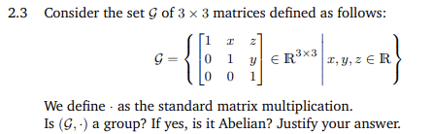
Question 2.3
Notes:
Diesenroth pg 64

Slide 17
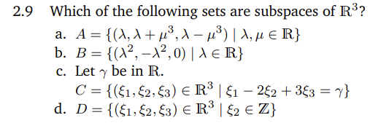
Question 2.9
Notes:
Diesenroth pg 66

Slide 18
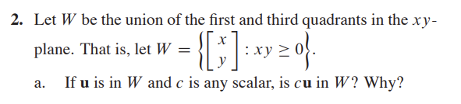
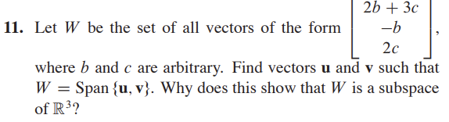
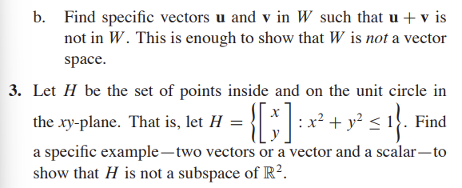
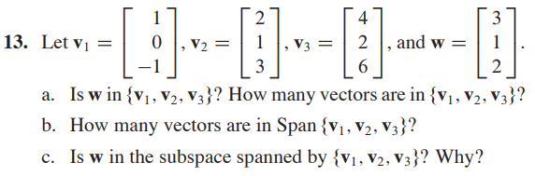
Section 4.1
Notes:
David C Lay - pg 195-196

Slide 19



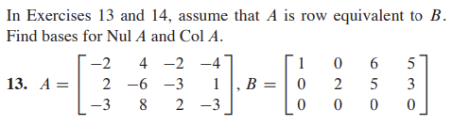
Section 4.3
Notes:
David C Lay - pg 213

Slide 20
Section 4.3
Notes:
David C Lay - pg 213

Slide 21
Solution
Deisenroth Book

Slide 22
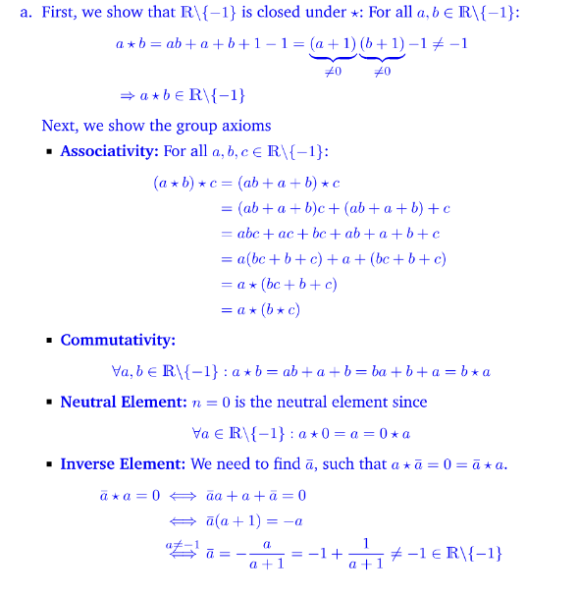
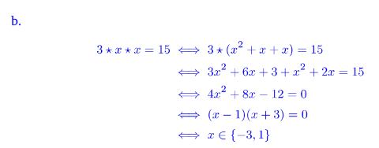
Question 2.1
Notes:
David C Lay - pg 213

Slide 23
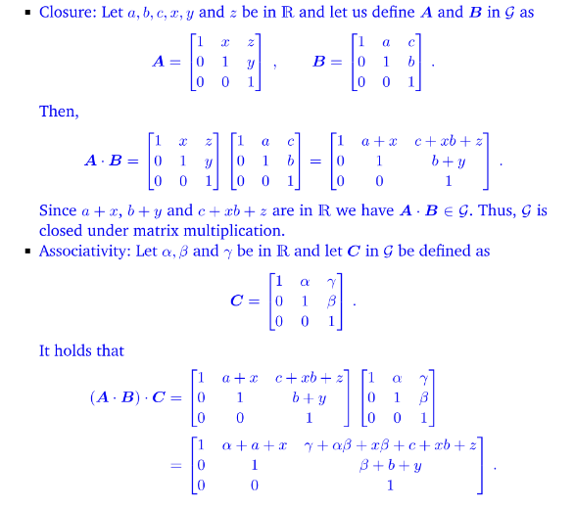
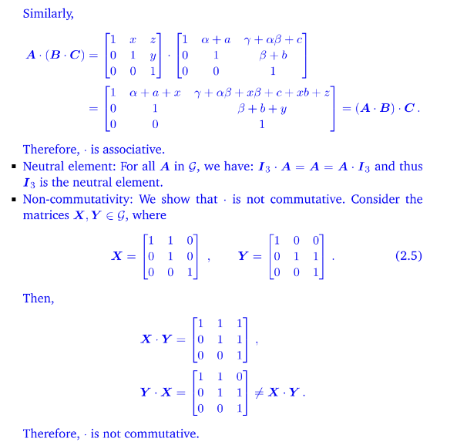
Question 2.3
Notes:
David C Lay - pg 213

Slide 24
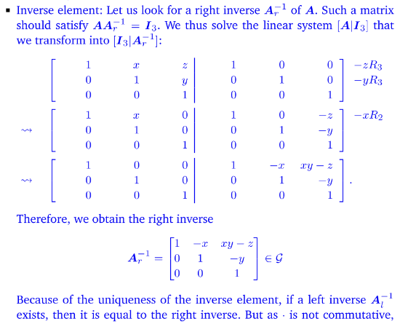
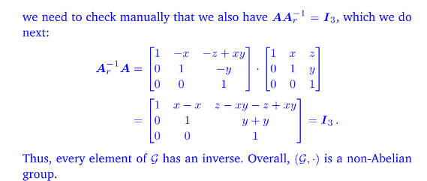
Question 2.3
Notes:
David C Lay - pg 213

Slide 25
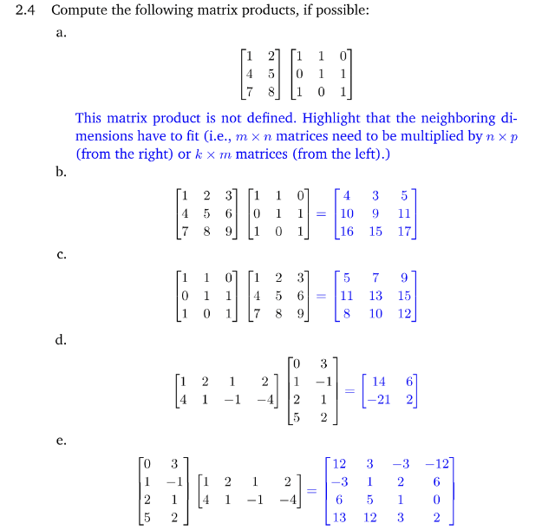
Question 2.4
Notes:
David C Lay - pg 213

Slide 26
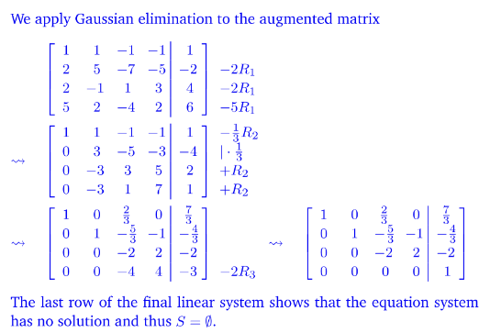
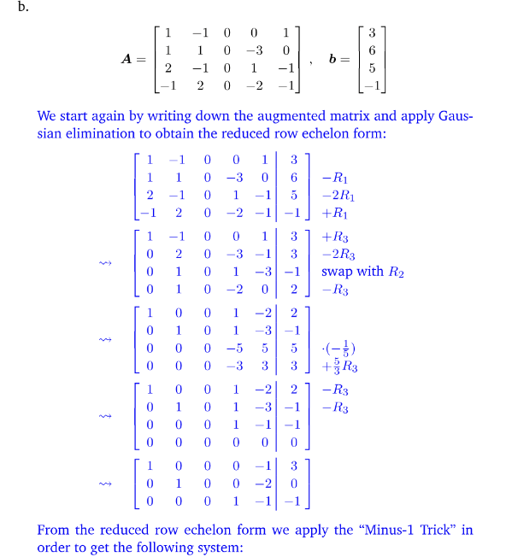
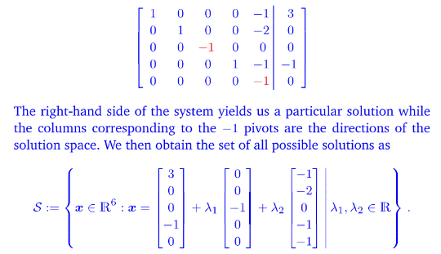
Question 2.5
Notes:
David C Lay - pg 213

Slide 27
Question 2.5
Notes:
David C Lay - pg 213

Slide 28
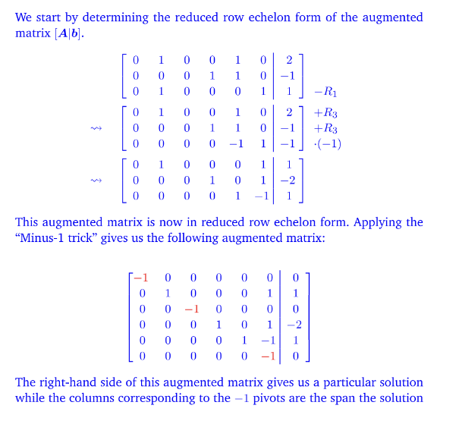
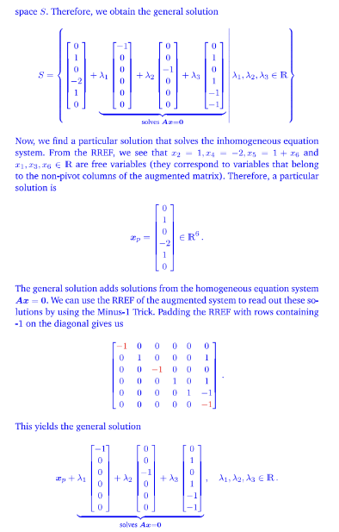
Question 2.6
Notes:
David C Lay - pg 213

Slide 29
Question 2.6
Notes:
David C Lay - pg 213

Slide 30
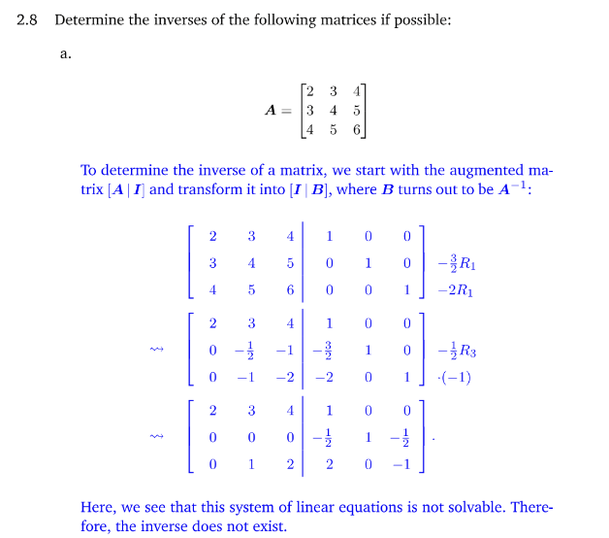
Question 2.8
Notes:
David C Lay - pg 213

Slide 31
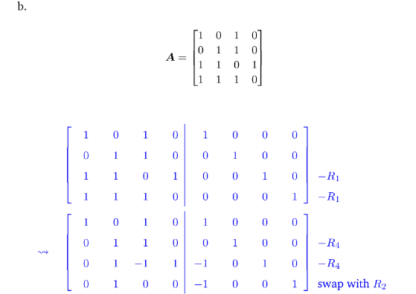
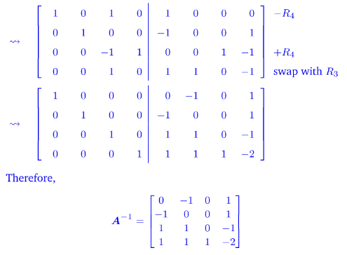
Question 2.8
Notes:
David C Lay - pg 213

Slide 32
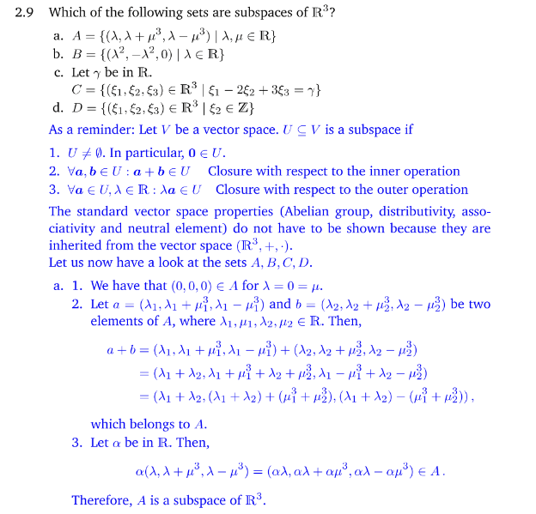
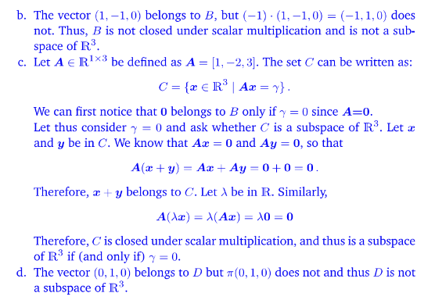
Question 2.9
Notes:
David C Lay - pg 213

Slide 33
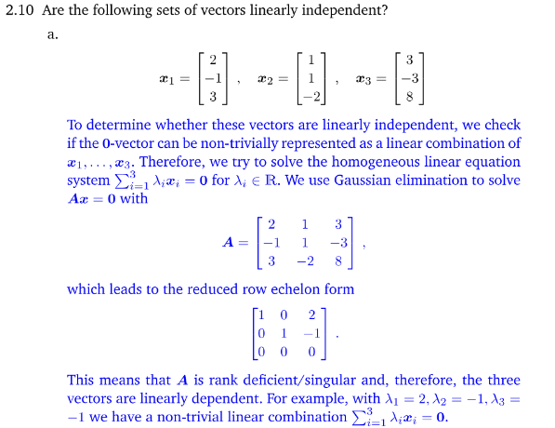
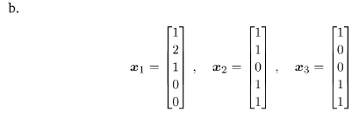
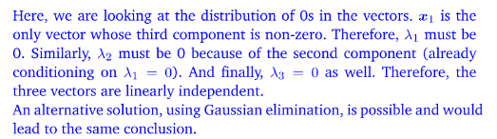
Question 2.10
Notes:
David C Lay - pg 213

